Slide 1

TEST DESIGN
MODULE 3 - LECTURE 3

Slide 2

LECTURE OUTLINE
Topic 1.
A recap of test design blue print from the last lecture
1
Topic 2.
Using best practices from day one and its benefits
2
Topic 3.
More insights on test design
3
Topic 4.
An enterprise testing solution
4
Topic 5.
The missing pieces of the solution
5
Topic 6.
Value gained after the efforts
6

Slide 3

A REVIEW OF THE TEST DESIGN BLUEPRINT

Slide 4

BLUE PRINT OF A TEST
Question we are trying to answer with the test
Setup of the system including hardware and software components
Load model
Load generating tool
Monitoring system
Test designing
First request and extensive checks
Scaling the request
Test execution
Aim for continuous execution
Test reporting
An easy to share reporting system

Slide 5
USING BEST PRACTICES FROM DAY ONE AND ITS BENEFITS

Slide 6
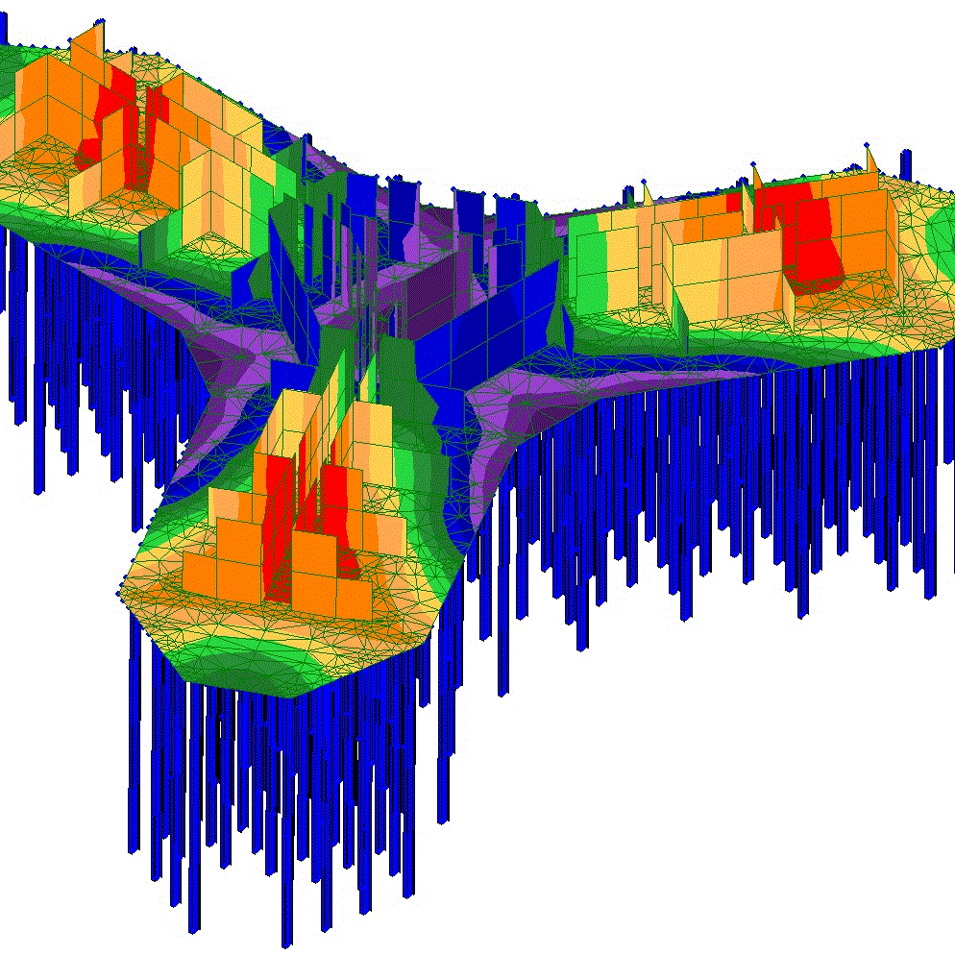
BUILDING THE RIGHT FOUNDATION
One problem faced when building a performance/resilience testing solution is that they tend to get complicated and unmanageable if the right approach is not utilized from the very start.
Never hesitate to put more effort from the start to build the right foundations before you start to build the real testing solution.

Slide 7
MORE INSIGHTS ON TEST DESIGN

Slide 8
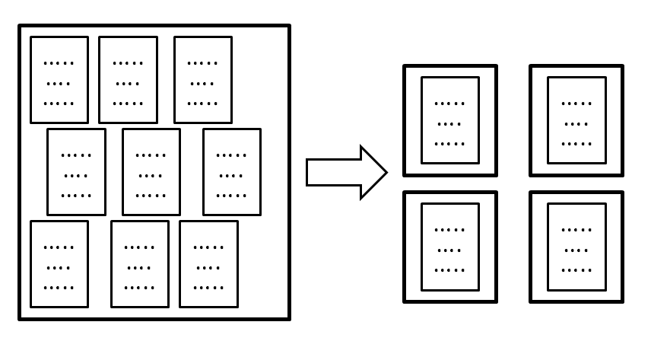
MORE INSIGHTS ON THE TESTING SOLUTION
Keep in mind that the system you are building the testing solution for is always changing.
It could move from one architecture to another at any point and in that case most of your testing solution pieces should be reusable.

Slide 9
AN ENTERPRISE TESTING SOLUTION

Slide 10

A TESTING SOLUTION
Some discussion about a project I have worked upon…
This project is a classical example about how more and more applications are being designed and later being modified to a microservices architecture

Slide 11

HOW THIS SOLUTION LOOKS LIKE?
Diagram time...

Slide 12

THE MISSING PIECES
Continuous execution
Repeatability of the results
Reusability of the baselines
A monitoring solution
It used to be manual scripts
Hence.. It was missing overall hands-free capabilities
This has been the story of many performance testing solutions I have worked with

Slide 13

THE ISSUES UNCOVERED
Undetected exceptions now clearly visible with clear analysis of logs leading to hotfixes and release
System monitoring data starting uncovering under and over-utilized resources and new bottlenecks
Historical overview of runs started uncovering new performance degradations being introduced with new commits

Slide 14
THANK YOU!

